Slide 1
2005 model
Model compare
2008 model
% ikba ikbb ikbe
p(1:3) = [1.848e-4; 4.272e-5; 3.048e-5;];% constitutive transcription
p(4:6) = [7.92; 0.0; 0.8; ]; % inducible transcription
p(7:9) = [0; 45; 45; ]; % inducible txn delay
p(10:12)= [3.0; 3.0; 3.0; ]; % Hill Coefficient
p(13:15)= [.0168; .0168; .0168; ]; % mRNA Degradation
p(16:18)= [.2448; .2448; .2448; ]; % translation rate
% Association/Dissociation Reactions
% ikba ikbb ikbe
p(19:21)= [30; 30; 30; ]; % IkB:NFkB Association, cyt
p(22:24)= [30; 30; 30; ]; % IkB:NFkB Association, nuc
p(25:27)= [6e-5; 6e-5; 6e-5; ]; % IkB:NFkB Dissociation, cyt
p(28:30)= [6e-5; 6e-5; 6e-5; ]; % IkB:NFkB Dissociation, nuc
p(31:33)= [1.35; .36; .54; ]; % IkB:IKK Association, cyt
p(34:36)= [.075; .105; .105; ]; % IkB:IKK Dissociation, cyt
p(37:39)= [11.1; 2.88; 4.2; ]; % IkBNFkB:IKK Association, cyt
p(40:42)= [.075; .105; .105; ]; % IkBNFkB:IKK Dissociation, cyt
p(43:45)= [30; 30; 30; ]; % IkBIKK:NFkB Association, cyt
p(46:48)= [6e-5; 6e-5; 6e-5; ]; % IkBIKK:NFkB Dissociation, cyt
% Import/Export Reactions
% ikba ikbb ikbe
p(49:51)= [.09; .009; .045; ]; % Free IkB import
p(52:54)= [.012; .012; .012; ]; % Free IkB export
p(55:57)= [.276; .0276; .138; ]; % IkBNFkB import
p(58:60)= [.828; .414; .414; ]; % IkBNFkB export
p(61) = 5.4; % Free NFkB import
p(62) = 0.0048; % Free NFkB export
% Protein Degradation Reactions
% ikba ikbb ikbe
p(63:65)= [.12; .18; .18; ]; % Free IkB Degradation, cyt
p(66:68)= [.12; .18; .18; ]; % Free IkB Degradation, nuc
p(69:71)= [6e-5; 6e-5; 6e-5; ]; % Bound IkB Degradation, cyt
p(72:74)= [6e-5; 6e-5; 6e-5; ]; % Bound IkB Degradation, nuc
p(75:77)=[.0018; .0006; .0012; ]; % IKK-mediated Free IkB Deg, cyt
p(78:80)=[.36; .12; .18; ]; % IKK-mediated Bound IkB Deg, cyt
% TEST of free IkB deg by IKK being equal to bound IkB deg
p(75:77)=p(78:80);
p(31:33)=p(34:36);
end
n = zeros(71,1); % NFkB Activation Module
%----- IkB:NFkB Module (including A20 synthesis/deg) -----
% ikba ikbb ikbe
n(1:3) = [7e-5; 1e-5; 1e-6 ]; % constitutive txn
n(4:6) = [8; 0.02; 0.3 ]; % inducible txn
n(7:9) = [3; 3; 3 ]; % Hill Coefficient
n(10:12)= [0; 37; 37 ]; % inducible txn delay
n(13:15)= [.035; 3e-3; 4e-3 ]; % mRNA Degradation
n(16:18)= [0.25; 0.25; 0.25 ]; % translation rate
n(19:21)= [0.09; 9e-3; 0.045]; % Free IkB Import
n(23:25)= [0.012; 0.012; 0.012]; % Free IkB Export
n(27:29)= [0.276; 0.0276; 0.138]; % IkB:NFkB Import
n(30:32)= [0.828; 0.414; 0.414]; % IkB:NFkB Export
n(22) = 5.4; % Free NFkB import
n(26) = 0.0048;% Free NFkB export
n(33:35)= [0.12; 0.18; 0.18 ]; % IkB deg cytoplasm
n(36:38)= [0.12; 0.18; 0.18 ]; % IkB deg nucleus
n(39:41)= [6e-5; 6e-5; 6e-5 ]; % Bound IkB deg cyt
n(42:44)= [6e-5; 6e-5; 6e-5 ]; % Bound IkB deg nuc
n(45:47)= [30; 30; 30 ]; % IkB:NFkB Asn cyt
n(48:50)= [30; 30; 30 ]; % IkB:NFkB Asn nuc
n(51:53)= [6e-5; 6e-5; 6e-5 ]; % IkB:NFkB Dsn cyt
n(54:56)= [6e-5; 6e-5; 6e-5 ]; % IkB:NFkB Dsn nuc
n(57:59)= [0.36; 0.12; 0.18 ]; % Free IkB + IKK deg
n(60:62)= [0.36; 0.12; 0.18 ]; % IkB:NFkB + IKK deg
% A20 Parameters
n(63) = 2e-06; % constitutive txn
n(64) = 0.4; % inducible txn
n(65) = 3; % Hill Coefficient
n(66) = 0; % inducible txn delay
n(67) = 0.035; % mRNA Degradation
n(68) = 0.25; % translation rate
n(69) = 30; % tsl delay
n(70) = 0.0029; % protein degradation
n(71) = 120; % promoter shutdown (experiments show ~120min)
Blue: same parameter value
Red: different values
Black: different parameter

Slide 2
2002 model
2005 model
% ikba ikbb ikbe
p(1:3) = [1.848e-4; 4.272e-5; 3.048e-5;];% constitutive transcription
p(4:6) = [7.92; 0.0; 0.8; ]; % inducible transcription
p(7:9) = [0; 45; 45; ]; % inducible txn delay
p(10:12)= [3.0; 3.0; 3.0; ]; % Hill Coefficient
p(13:15)= [.0168; .0168; .0168; ]; % mRNA Degradation
p(16:18)= [.2448; .2448; .2448; ]; % translation rate
% Association/Dissociation Reactions
% ikba ikbb ikbe
p(19:21)= [30; 30; 30; ]; % IkB:NFkB Association, cyt
p(22:24)= [30; 30; 30; ]; % IkB:NFkB Association, nuc
p(25:27)= [6e-5; 6e-5; 6e-5; ]; % IkB:NFkB Dissociation, cyt
p(28:30)= [6e-5; 6e-5; 6e-5; ]; % IkB:NFkB Dissociation, nuc
p(31:33)= [1.35; .36; .54; ]; % IkB:IKK Association, cyt
p(34:36)= [.075; .105; .105; ]; % IkB:IKK Dissociation, cyt
p(37:39)= [11.1; 2.88; 4.2; ]; % IkBNFkB:IKK Association, cyt
p(40:42)= [.075; .105; .105; ]; % IkBNFkB:IKK Dissociation, cyt
p(43:45)= [30; 30; 30; ]; % IkBIKK:NFkB Association, cyt
p(46:48)= [6e-5; 6e-5; 6e-5; ]; % IkBIKK:NFkB Dissociation, cyt
% Import/Export Reactions
% ikba ikbb ikbe
p(49:51)= [.09; .009; .045; ]; % Free IkB import
p(52:54)= [.012; .012; .012; ]; % Free IkB export
p(55:57)= [.276; .0276; .138; ]; % IkBNFkB import
p(58:60)= [.828; .414; .414; ]; % IkBNFkB export
p(61) = 5.4; % Free NFkB import
p(62) = 0.0048; % Free NFkB export
% Protein Degradation Reactions
% ikba ikbb ikbe
p(63:65)= [.12; .18; .18; ]; % Free IkB Degradation, cyt
p(66:68)= [.12; .18; .18; ]; % Free IkB Degradation, nuc
p(69:71)= [6e-5; 6e-5; 6e-5; ]; % Bound IkB Degradation, cyt
p(72:74)= [6e-5; 6e-5; 6e-5; ]; % Bound IkB Degradation, nuc
p(75:77)=[.0018; .0006; .0012; ]; % IKK-mediated Free IkB Deg, cyt
p(78:80)=[.36; .12; .18; ]; % IKK-mediated Bound IkB Deg, cyt
% TEST of free IkB deg by IKK being equal to bound IkB deg
p(75:77)=p(78:80);
p(31:33)=p(34:36);
end
% Set Rate Parameters
a1 = 1.35; % Association
a2 = 0.36;
a3 = 0.54;
a4 = 30;
a5 = 30;
a6 = 30;
a7 = 11.1;
a8 = 2.88;
a9 = 4.2;
d1 = 0.075; % Dissociation
d2 = 0.105;
d3 = 0.105;
d4 = 0.03;
d5 = 0.03;
d6 = 0.03;
r1 = 0.2442; % IKK-mediated IkB deg
r2 = 0.09;
r3 = 0.132;
r4 = 1.221;
r5 = 0.45;
r6 = 0.66;
tr1 = 0.2448; % IkB translation
tr2 = 0.99; % Inducible IkBa txn
tr3 = 0.0168; % IkB mRNA deg
deg1 = 0.0067; % Constitutive free IkB deg
deg4 = 0.0014; % Constitutive bound IkB deg
k1 = 5.4; % NFkB Nuclear Import
k01 = 0.0048; % NFkB Nuclear Export
k2 = 0.8294; % IkBa:NFkB Nuclear Export
k2_2= 0.5 * k2; % IkBe/b:NFkB Nuclear Export
tp1 = 0.018; % IkB Nuclear Import
tp2 = 0.012; % IkB Nuclear Export
tr2a= 9.2137e-5;% Constitutive txn
tr2b= 1.0701e-5;
tr2e= 7.644e-6;
h = 2; % Hill Coefficient for Inducible IkBa txn
k02 = 0.0072; %IKK Degradation Rate

Slide 3
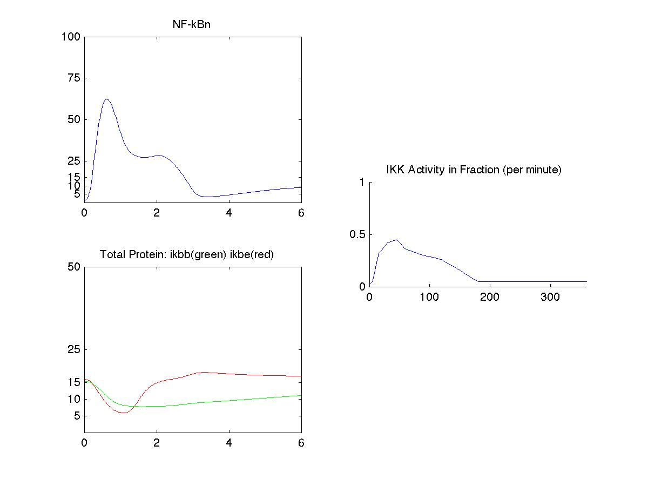
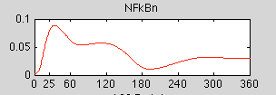
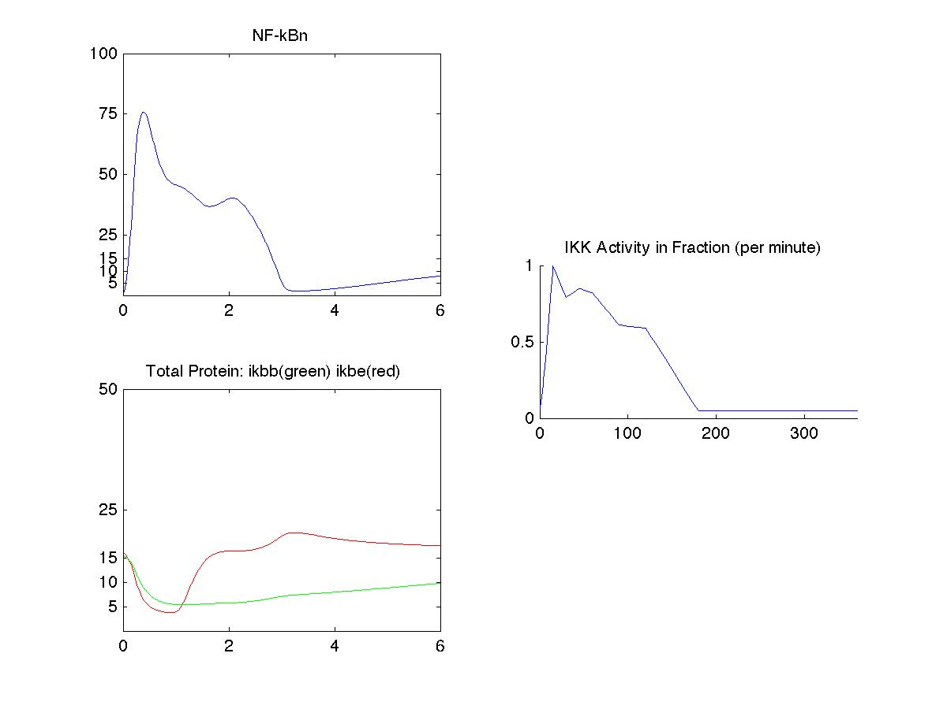
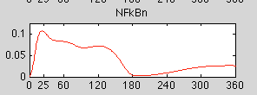
1ng/ml
2005 model
2008 model
100ng/ml

Slide 4
Single cell simulation comparison
5000 ng/ml LPS
4 pars vary
3 pars vary
IKK
IRF3np
NFkBn

Slide 5
Single cell simulation comparison
5 ng/ml LPS
4 pars vary
3 pars vary
IKK
IRF3np
NFkBn

